Slide 1
WEBMONK (DAY - 1) 💻
Topics covered:
* Dev Environment Setup * HTML (Basics, Document Structure, Anatomy of tags, Mostly used tags, Special Characters)
* Semantic HTML (HTML5 Guidelines, new additions, small HTML Blog project)

Slide 2
DEV ENVIRONMENT SETUP

Slide 3
Signup for GitHub account.
Any updated browser.
Git & GitHub setup
VS Code setup & extensions (Emmet, Live Server & HTML CSS Support)

Slide 4
HTML

Slide 5
BASICS OF HTML
HTML – HyperText Markup Language
Created in 1991 by Tim Berners-Lee, known as founding father of modern Internet.
Initial version released in 1993.
Managed by W3C.
Latest version: HTML5

Slide 6
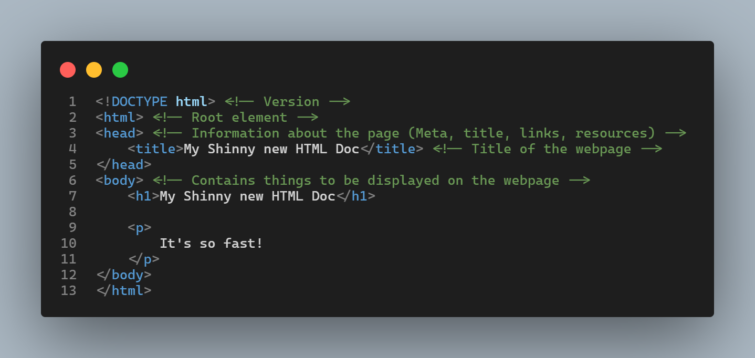
BASIC DOCUMENT STRUCTURE
* This is basic HTML required to view in browser.
* HTML is rendered sequentially from top to bottom.
* Let’s learn a little about this syntax

Slide 7
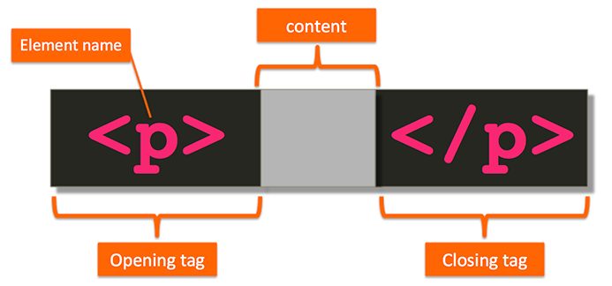
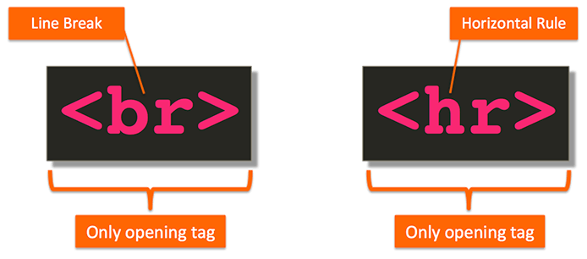
ANATOMY OF HTML TAG
* HTML markup consists of tags that describe the content and tell the browser how to structure & display it.
* A pair of HTML tags and their enclosed content are collectively called an element.

Slide 8
DIFFERENT TYPES OF ELEMENTS
BLOCK LEVEL ELEMENT
INLINE ELEMENTS
Render to begin on a new line (by default)
May contain inline or other block-level elements
For ex: <div>, <p>, <h1>-<h6>, <ul>, <ol>, <li>
Render on the same line (by default)
May only contain other inline elements
For ex: <a>, <b>, <strong>, <img>, <span>

Slide 9
MOSTLY USED TAGS
<h1>, <h2>..,<h6> tag - HTML headings
<p> tag – Paragraph
<img> tag – Image on page
<!-- --> tag – For comments in code
<br> tag – Line Break
<a> tag – Links in HTML document
<sup>, <sub> tag – Superscript & Subscript small text respectively.
<strong>, <em> tag – Text formatting (bold & italic respectively).
<ul>, <ol> tag – Unordered & ordered lists
<table> tag – Table in HTML document
<div> tag – Division tag used as a block in a document used mainly to layout sections in the design of the page.
<input> tag – To take different kinds of input from user.
<form> tag – Form for user input which wraps the input fields.
<style> tag - Wraps or includes CSS code.
<script> tag – Wraps or includes JS code.

Slide 10
SEMANTIC HTML

Slide 11
WHAT SEMANTIC ELEMENTS MEANS?
Introduced in HTML5.
These describes the meaning of element to both the browser and the developer.
These are block level element.
These helps in accessibility features.
For Ex: <article>, <aside>, <footer>, <header>, <main>, <nav>, <section>

Slide 12
WEBMONK (DAY - 2) 💻
Topics covered:
* CSS Intro, anatomy & usage
* Power Struggle, Attributes & Selectors
* CSS Inheritance, Last Rule, Specificity
* Unit Introduction
* Box Model * Media Queries

Slide 13
CSS INTRO, ANATOMY & USAGE

Slide 14
INTRODUCTION TO CSS
CSS stands for Cascading Style Sheets.
CSS was first proposed by Håkon Wium Lie on October 10, 1994. At the time, Lie was working with Tim Berners-Lee at CERN.
Initial version released in 1996.
Managed by W3C.
Latest version: CSS3.
CSS describes how HTML elements are to be displayed on screen, paper, or in other media.
HTML – Structure, CSS – Layout & Look.
There is a saying: Everyone’s CSS is different.

Slide 15
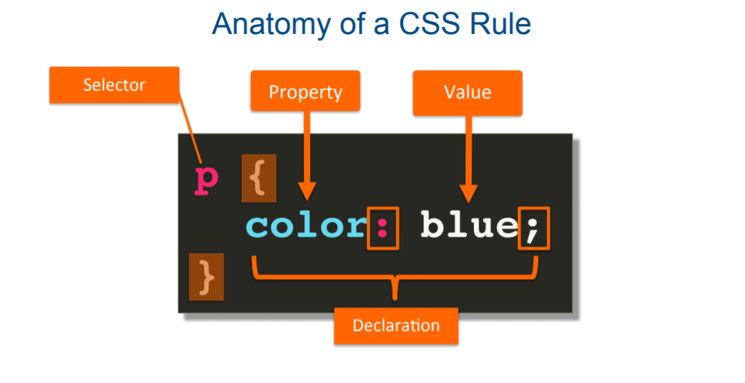
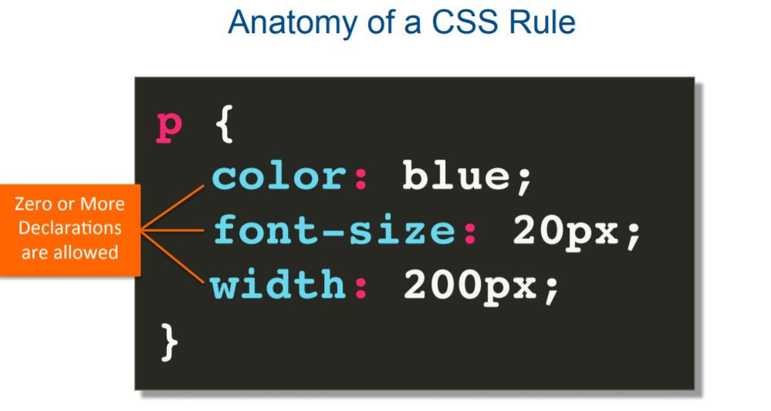
ANATOMY OF CSS
CSS properties and values are enclosed inside the braces`{ }` .
Property and value together are known as declaration.
We can define as many declarations we want inside a single selector.

Slide 16
USAGE OF CSS
Inline CSS
Internal CSS
External CSS

Slide 17
POWER STRUGGLE, ATTRIBUTE & SELECTORS

Slide 18
POWER STRUGGLE
we have 3 ways of using CSS:
Inline CSS
Internal CSS
External CSS
inline CSS is given precedence over Internal CSS.
internal CSS is given precedence over External CSS.
but as a convention we’ll mostly write CSS in External Stylesheet for better readability and code sharing.

Slide 19
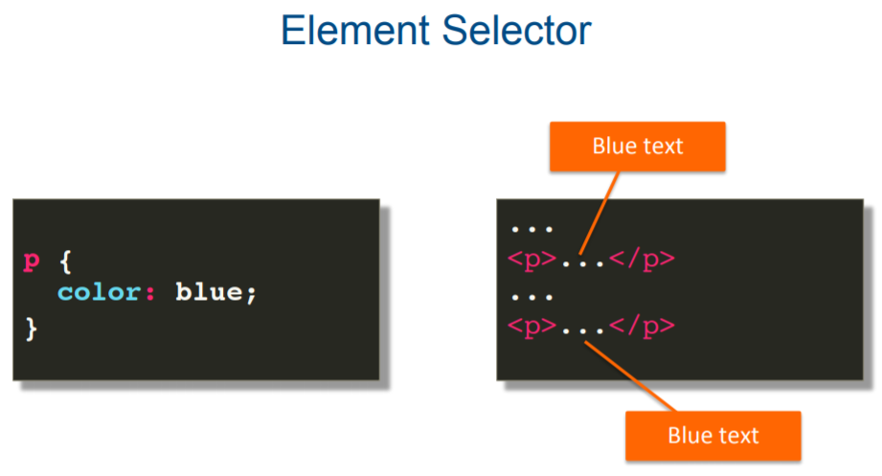
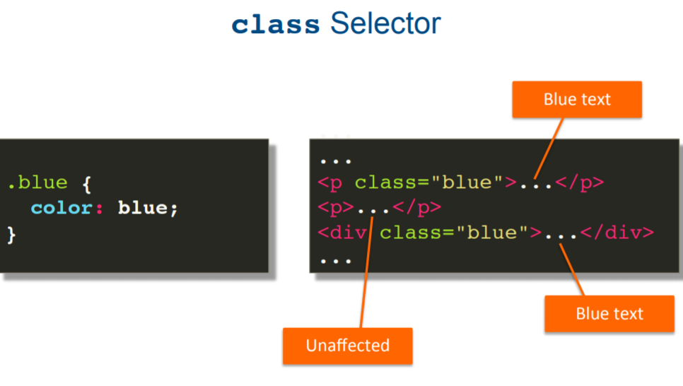
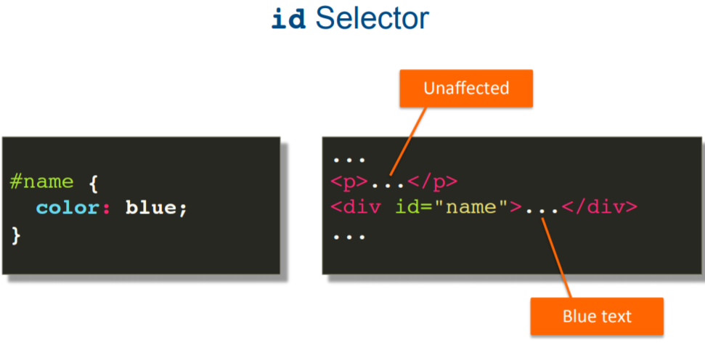
CSS SELECTORS
element, class & id Selectors

Slide 20
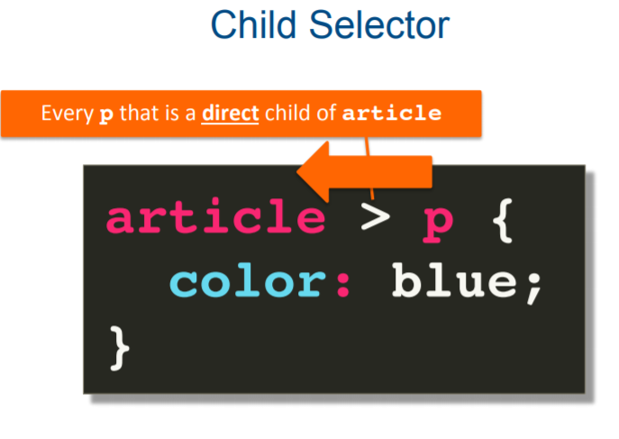
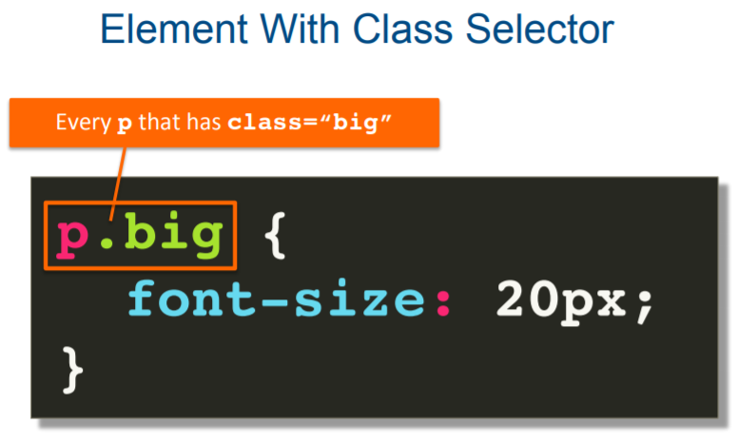
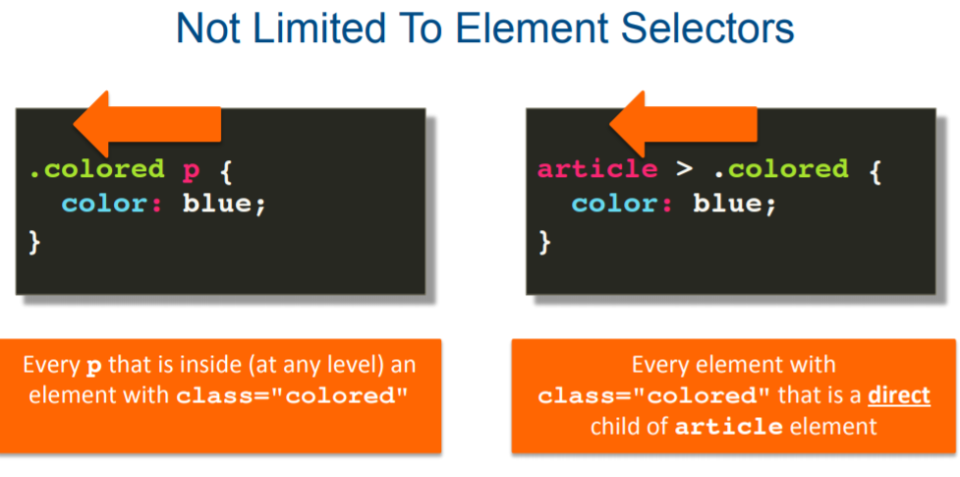
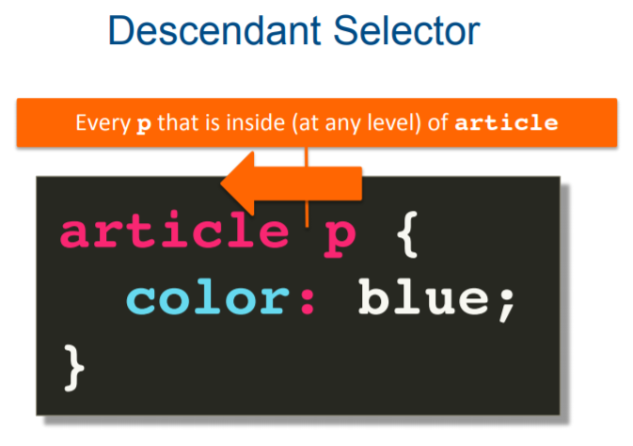
COMBINING CSS SELECTORS
element, class & id Selectors

Slide 21
CSS INHERITANCE, LAST RULE, SPECIFICITY

Slide 22
CSS INHERITANCE
inheritance controls what happens when no value is specified for a property on an element. These describes the meaning of element to both the browser and the developer.
CSS properties can be categorized in two types:
Inherited properties: which by default are set to the computed value of the parent element.
Non-Inherited properties: which by default are set to initial value of the property.

Slide 23
LAST RULE
CSS is processed by browser from top to bottom.
if a CSS property is applied to a selector twice or more times in a document, the last one is chosen as the applicable one.

Slide 24
SPECIFICITY
a CSS property applied to a element using ID selector has precedence over property applied using Class selector.
a CSS property applied to a element using Class selector has precedence over property applied using element name (tag name).
specificity works in combination with Last Rule.

Slide 25
UNIT INTRODUCTION

Slide 26
PIXELS, PERCENTAGE, EM, REM
Pixel – Absolute unit of measurement. Broadly speaking, one pixel represents one dot on the screen.
Percentage – Relative unit of measurement compared to outer block level element.
Em – Relative unit of measurement compared to immediate parent element. 1em = 16px, which is also default browser font size.
Rem – Relative unit of measurement compared to root. 1rem = 16px, which is also default browser font size.

Slide 27
BOX MODEL

Slide 28
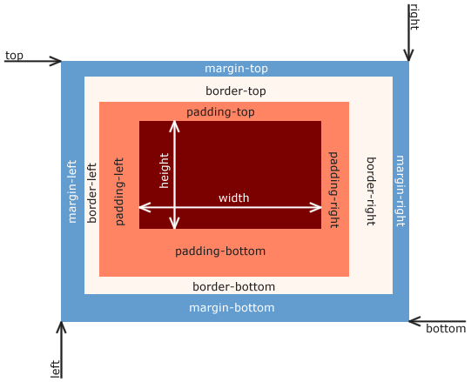
BOX MODEL INTRODUCTION
* the CSS box model refers to how HTML elements are modeled in browser engines and how dimension of those HTML elements are derived from CSS properties. It is a fundamental concept for the composition of HTML webpages.
* the guidelines of the box model are described by web standards World Wide Web Consortium (W3C) specifically the CSS Working Group.
* each of those boxes has five modifiable dimensions:
- the height and width describe dimensions of the actual content of the box (text, images, ...)
- the padding describes the space between this content and the border of the box
- the border is any kind of line (solid, dotted, dashed...) surrounding the box, if present
- the margin is the space around the border

Slide 29
MEDIA QUERY

Slide 30
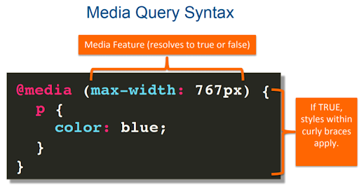
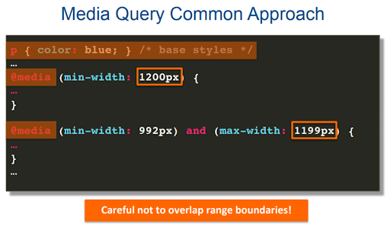
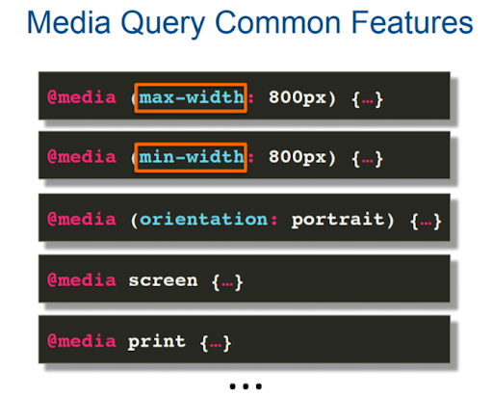
MEDIA QUERY
element, class & id Selectors

Slide 31
Some common responsive breakpoints
@media (min-width:320px) { /* smartphones, iPhone, portrait 480x320 phones */ }
@media (min-width:481px) { /* portrait e-readers (Nook/Kindle), smaller tablets @ 600 or @ 640 wide. */ }
@media (min-width:641px) { /* portrait tablets, portrait iPad, landscape e-readers, landscape 800x480 or 854x480 phones */ }
@media (min-width:961px) { /* tablet, landscape iPad, lo-res laptops ands desktops */ }
@media (min-width:1025px) { /* big landscape tablets, laptops, and desktops */ }
@media (min-width:1281px) { /* hi-res laptops and desktops */ }

Slide 32
LET’S DIVE INTO SOME GIT, SHALL WE?

Slide 33
WEBMONK (COURSE DAY - 2) 💻
Topics covered:
* All about git & GitHub

Slide 34
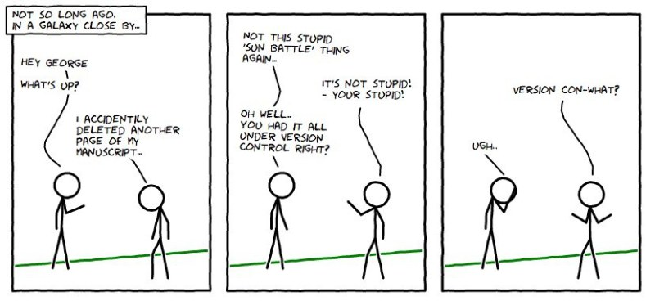

Slide 35
GIT

Slide 36
SO WHAT IS THIS GIT?
Git is an example of a distributed version control system (DVCS) commonly used for open source and commercial software development.
DVCSs allow full access to every file, branch, and iteration of a project, and allows every user access to a full and self-contained history of all changes.
Unlike once popular centralized version control systems, DVCSs like Git don’t need a constant connection to a central repository.
Developers can work anywhere and collaborate asynchronously from any time zone.
Seeing a transparent history of changes, who made them, and how they contribute to the development of a project helps team members stay aligned while working independently.

Slide 37
LET’S DEFINE OURSELVES FIRST TO GIT
git config --global user.email "you@example.com"
git config --global user.name "Your Name"

Slide 38
LOCAL FIRST
first lets make a git folder in our computer
git init
add a file to the folder
git add index.html
git add .
git commit -m “new file added” index.html
if you don’t provide file after the comment, everything you have done will be committed.

Slide 39
IGNORE TRACKING ?
create a file called .gitignore
write the file names that should be ignored by git
commit the file

Slide 40
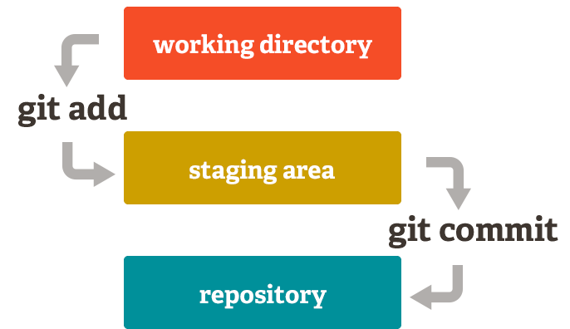

Slide 41
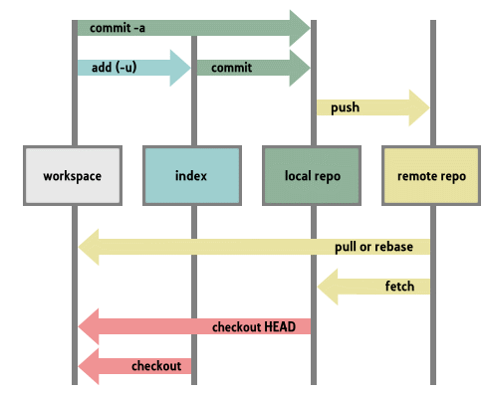

Slide 42
GIT LOGS
git log - shows the logs of git
this logs consist of commit logs.
these contains information like:
commit id
author
date
commit message
file changes (--stat)

Slide 43
DISCARD CHANGES
unstage the file to current commit (HEAD):
git reset HEAD <file>Unstage everything –
retain changes:
git reset
discard all local changes, but save them for later:
git stash
discard everything permanently:
git reset --hard

Slide 44
REMOVE A FILE
git rm somefile.txt
git commit –m ‘removed’
git push origin

Slide 45


Slide 46
AND WHAT IS THIS OCTOPUS? 🤷‍♂️🤷‍♀️
GitHub is a Git repository hosting service, but it adds many of its own features. While Git is a command line tool, GitHub provides a Web-based graphical interface. It also provides access control and several collaboration features, such as a pull requests, issues, wikis and basic task management tools for every project.

Slide 47
PULLING A REPOSITORY/EDITING
lets pull a repository from GitHub
git clone https://github.com/open-devs/test
git remote add origin https://github.com/open-devs/test
edit the file a.txt
git commit –am ‘something added’
git push origin

Slide 48
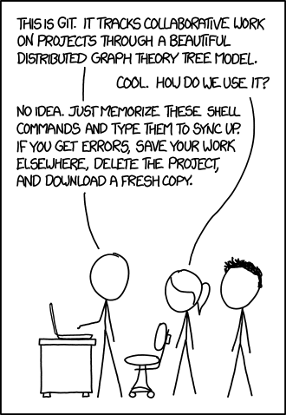
THANK YOU
let’s head over to VS Code to see the magic…

